Slide 1

Brain Lesion Segmentation from MRI Images
May 2020

Slide 2

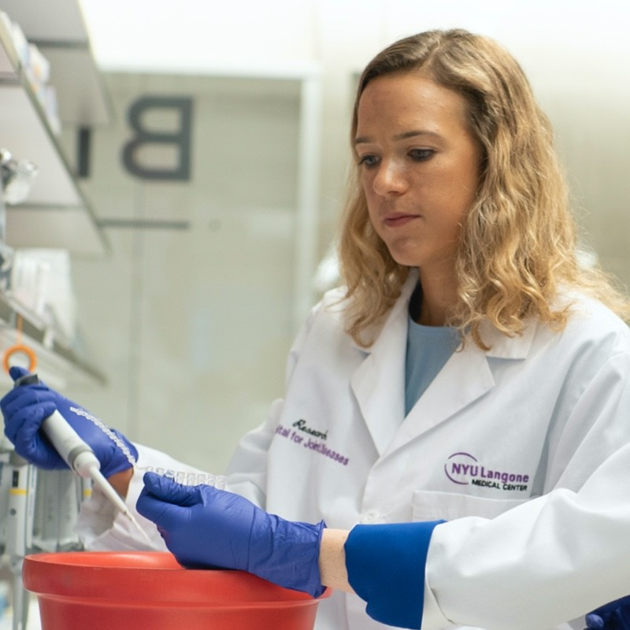
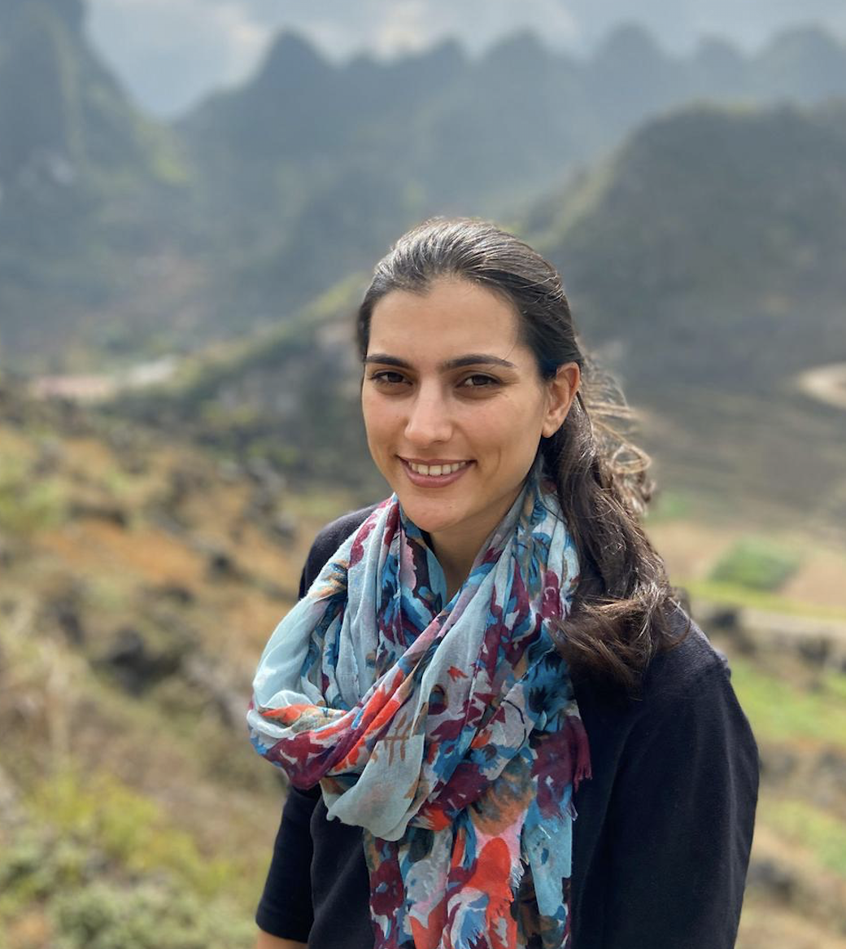
Dajr Alfred
Nitzan Segal
Barr Morgenstein

Slide 3
Outline
Background
BraTS dataset
Segmentation models
Code demonstration (GitHub)

Slide 4
Background
MRI scans are essential in the effort of diagnosing and treating brain tumors
Often, the MRI data is subject to added artifacts resulting in bias to the scans, affecting the segmentation and the diagnostic process models
Computer algorithms for brain lesion segmentation aim to isolate malignant tumorous regions from the healthy tissue, in a quick and more accurate manner, compared to the manual segmentation process, helping to provide a successful treatment

Slide 5
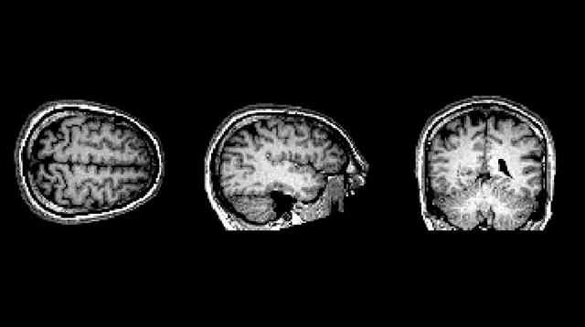

Slide 6
BraTS dataset
The brain MRI data was provided by the MICCAI BraTS Challenge database (fully anonymized images from the Cancer Imaging Archive). Images are in a *.mha format
The dataset consists of approximately 220 high-grade glioma cases and 54 low-grade cases. Each case includes T1, T1C, T2, Flair , Train cases additionally include ground truth labels
The segmentation is aimed to label the cases by: 1 necrosis 2 edema 3 non-enhancing tumor 4 enhancing tumor 0 else

Slide 7
BraTS dataset
Each patient MRI produces around 600 images → The four sequences produce 155 slices each
The preprocessing stage is designed to transforms scans of same slice into strip of all the images
The models are trained on randomly selected 33x33 patches of MRI strip images. Each input has 4 channels, one for each imaging sequence

Slide 8
Segmentation models
In this project we explored the models:
U-Net architecture, a 4 layers model
Fully Convolutional Neural Network (FCN) with 4 convolutional, max-pooling layers followed by convolution and softmax layers
CE-Net (?)
*Each model was tested for its efficiency on a validation dataset

Slide 9

Code demonstration (GitHub)

Slide 10
References
Havaei, M., Davy, A., Warde-Farley, D., Biard, A., Courville, A., Bengio, Y., ... & Larochelle, H. (2017). Brain tumor segmentation with deep neural networks. Medical image analysis, 35, 18-31
Menze, B. H., Jakab, A., Bauer, S., Kalpathy-Cramer, J., Farahani, K., Kirby, J., ... & Lanczi, L. (2014). The multimodal brain tumor image segmentation benchmark (BRATS). IEEE transactions on medical imaging, 34(10), 1993-2024
Ronneberger, O., Fischer, P., & Brox, T. (2015, October). U-net: Convolutional networks for biomedical image segmentation. In International Conference on Medical image computing and computer-assisted intervention (pp. 234-241). Springer, Cham
Gu, Z., Cheng, J., Fu, H., Zhou, K., Hao, H., Zhao, Y., ... & Liu, J. (2019). CE-Net: context encoder network for 2D medical image segmentation. IEEE transactions on medical imaging, 38(10), 2281-2292

